Slide 1

Collaboration to Drive Optimized Supportive Care for Lassa Fever
William A. Fischer, MD
Division of Pulmonary and Critical Care Medicine
Director of Emerging Pathogens
Institute of Global Health and Infectious Diseases
The University of North Carolina at Chapel Hill

Slide 2
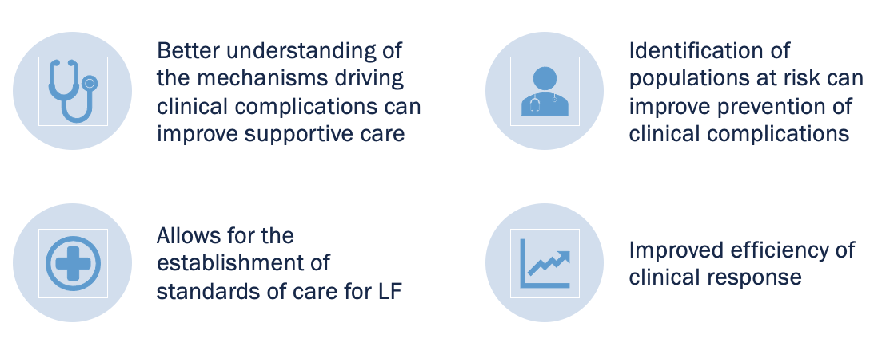
Benefits of a Research Collaboration on Clinical Care for Lassa Fever

Slide 3
What do we know?

Slide 4

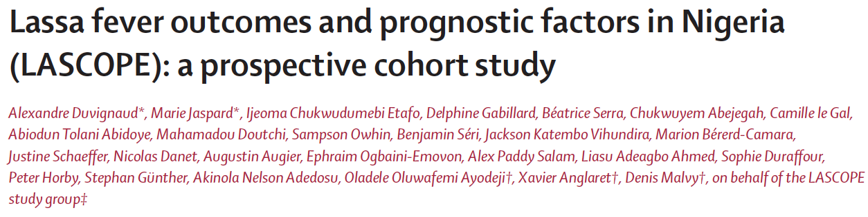
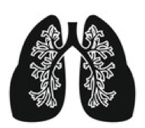

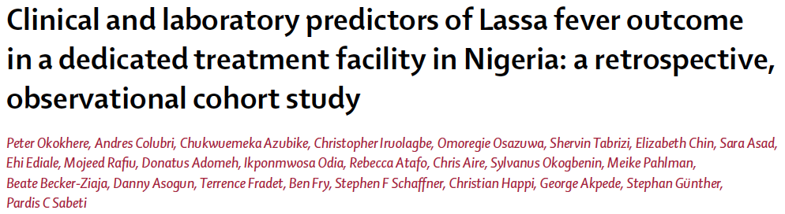


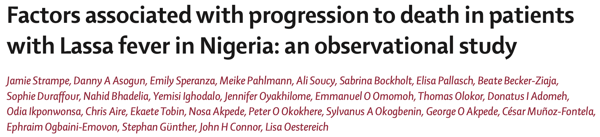

Delirium/coma/seizure Dizziness | 2-16% 25-29%
Oxygen saturation <92% Oxygen supplementation Duration | 7-15% 18% 3d (2-7)
Systolic BP <90mmHg | 5-22%
Glucose <54mg/dl AST>3xUL | 7-15% 38-41%
No dysfunction ARF RRT | 83-87% 2-28% 8%
Bleeding Platelets <80 | 19-34% 11-14%

Slide 5
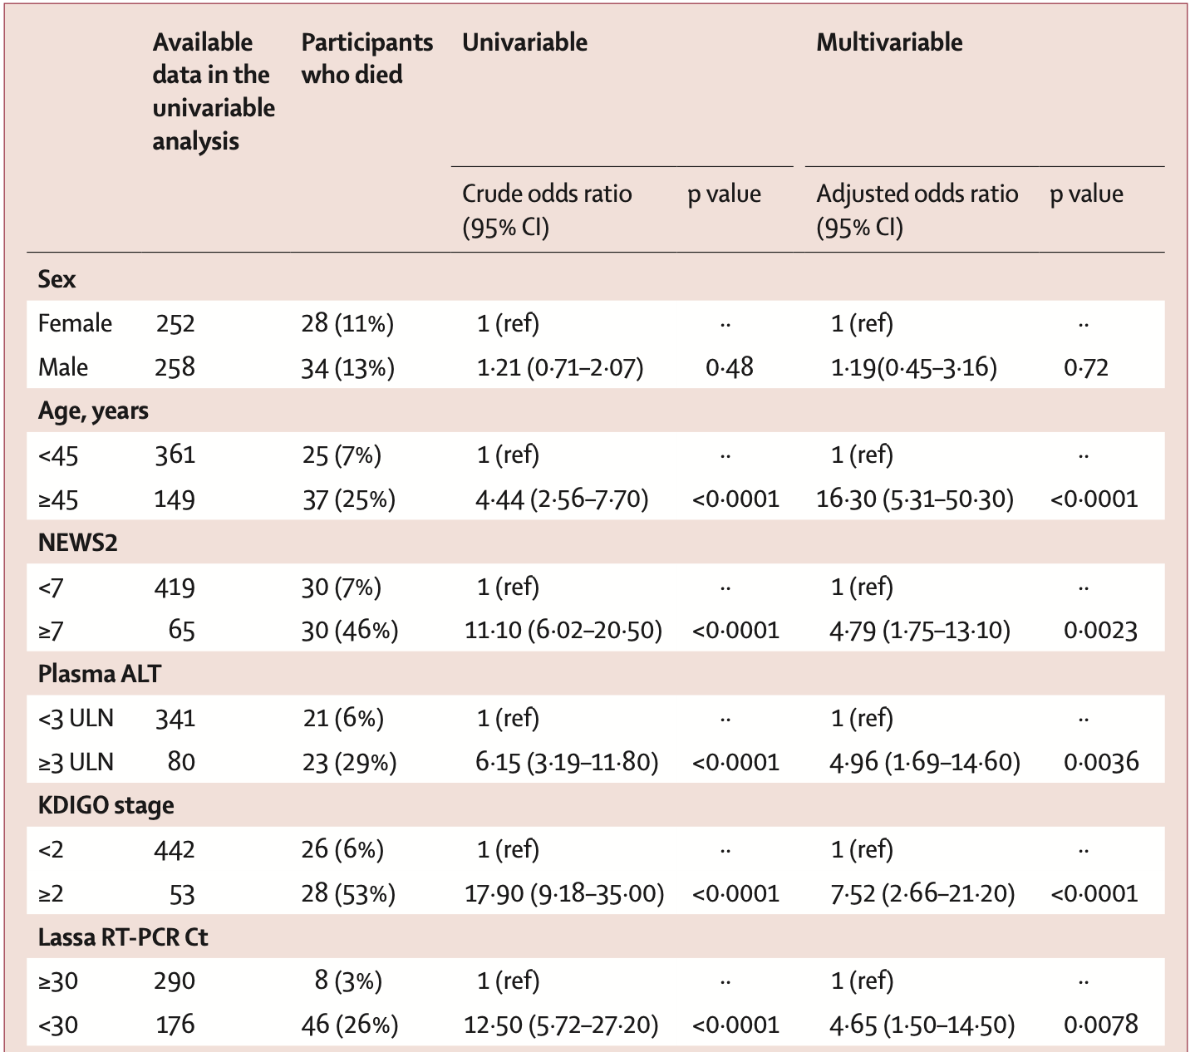
Host and Disease-Related Factors Associated with Mortality
Age
Organ injury
ARF
Liver injury
Bleeding
Severe CNS disease?
Viral Load
Duvignaud, A Lancet ID 2022
Okokhere Lancet ID 2018
Strampe Lancet ID 2021

Slide 6
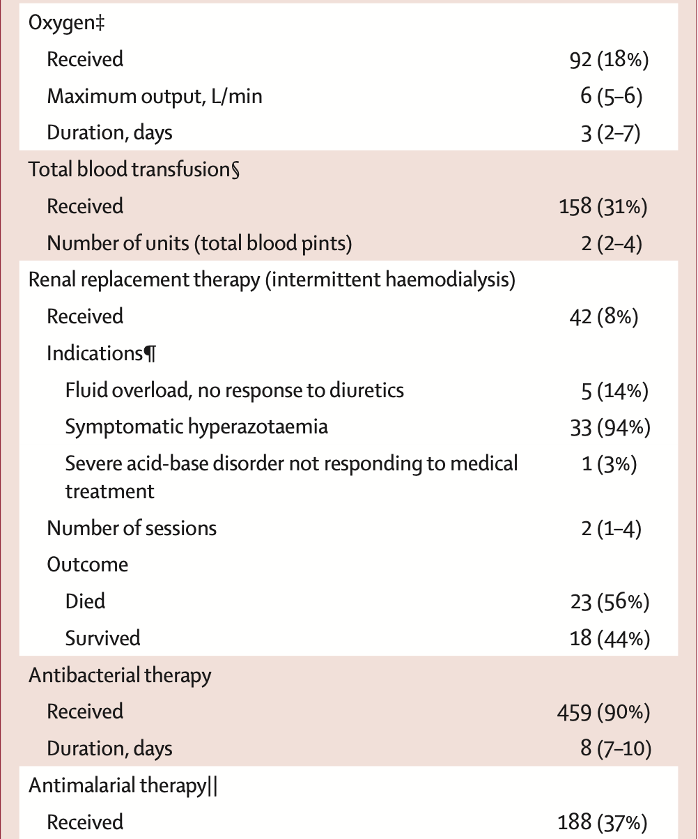
Optimized Supportive Care
18% received oxygen
~6L for 2-7 days
Vasopressors?
8% received RRT
Azotemia for 2 sessions
CFR 56%
31% received blood transfusions
~2 pints
90% received antibiotics
Duvignaud, A Lancet ID 2022

Slide 7
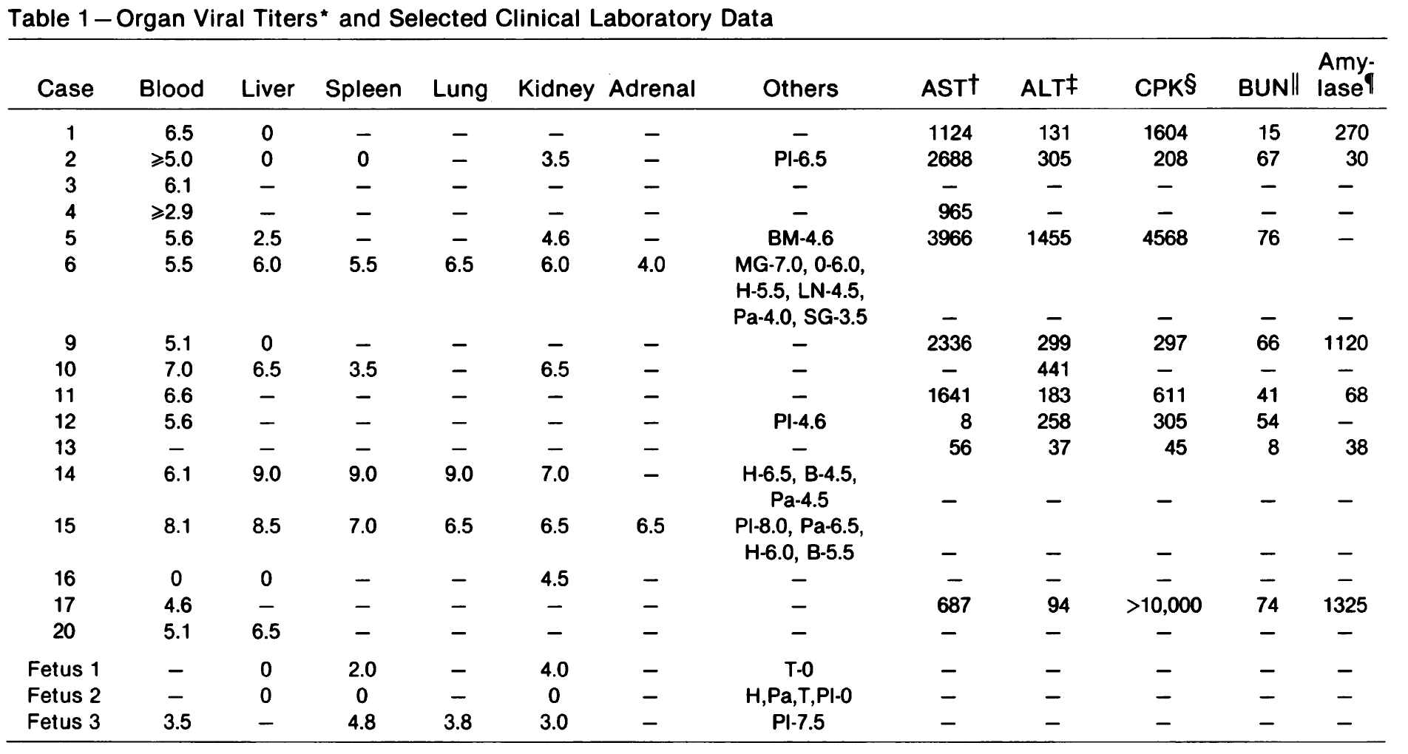
LASV Dissemination and Pathology
** Brain, Heart, Kidney, Bone Marrow, Placenta, Mammary gland
Walker, D. AJP 1989

Slide 8
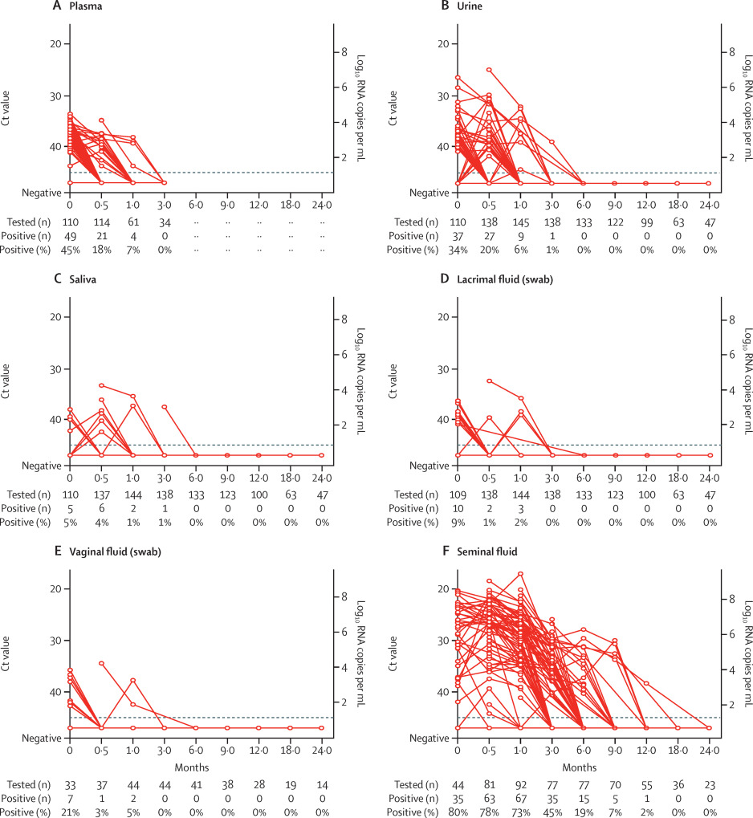
LASV Compartmentalization + Persistence
35 (80%) of 44 M had LASV RNA in seminal fluid at month 0 with a median cycle threshold of 26·5. Lassa virus RNA remained detectable up to month 12 in seminal fluid
Thielebein, A Lancet Microbe 2022

Slide 9
Acute Kidney Injury
Review

Slide 10
What are the key clinical questions we need to answer to improve LF care?

Slide 11
Direct viral injury
Hypoglycemia
Elyte abnormalities
Medications
Delirium/coma/seizure Dizziness | 2-16% 25-29%
Oxygen saturation <92% Oxygen supplementation Duration | 7-15% 18% 3d (2-7)
Fluid resuscitation?
Acidosis
Fluid responsive?
Myocardial dysfunction
Myocarditis?
Systolic BP <90mmHg | 5-22%
Glucose <54mg/dl AST>3xUL | 7-15% 38-41%
Hepatic dysfunction?
Glycogen depletion?
No dysfunction ARF RRT | 83-87% 2-28% 8%
Late presentation
Fluid resuscitation?
Acidosis
Bleeding Platelets <80 | 19-34% 11-14%
DIC?
Platelet dysfunction

Slide 12
Long-term Sequelae + Subgroups
Sensorineural hearing loss
Other post-LF complications
Viral persistence
Pregnant people
<5 years of age
>50 years of age
Virus Lineage and outcomes

Slide 13
What research studies are actively addressing these gaps to improve clinical care?

Slide 14
Is there interest in a collaboration + Important research gaps related to LF clinical care?

Slide 15
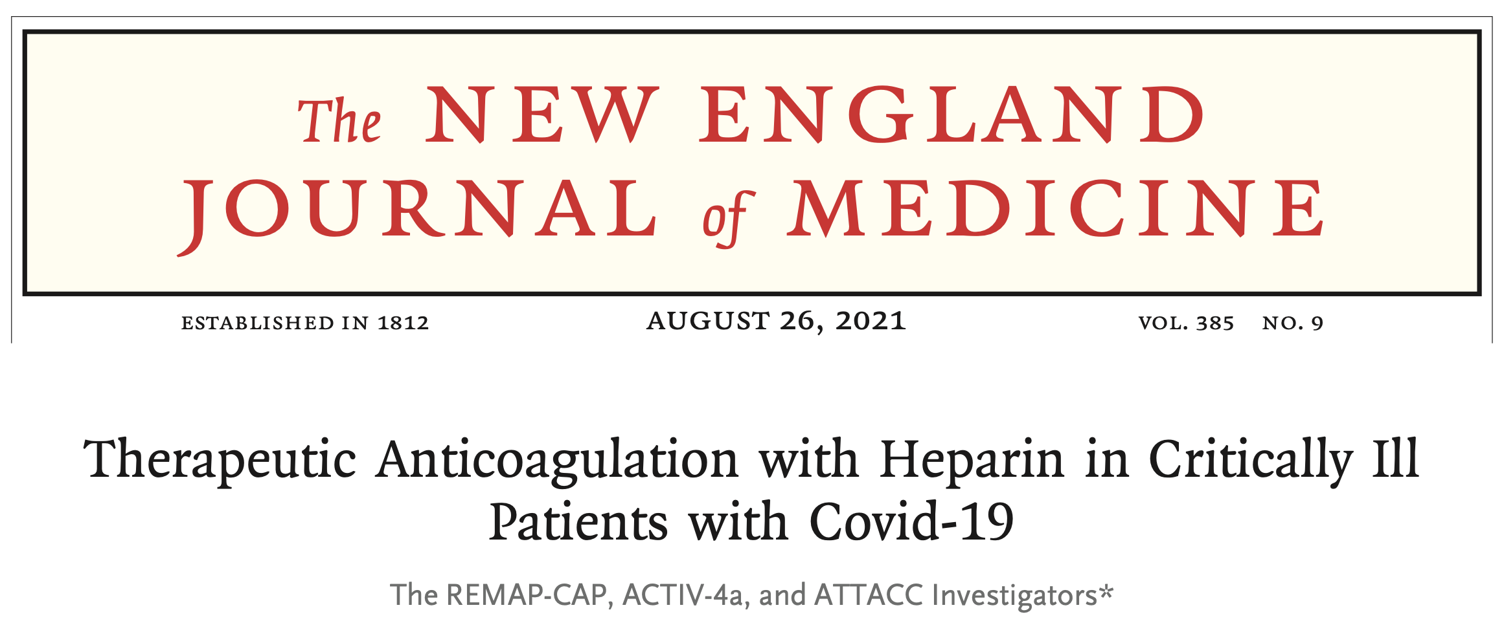
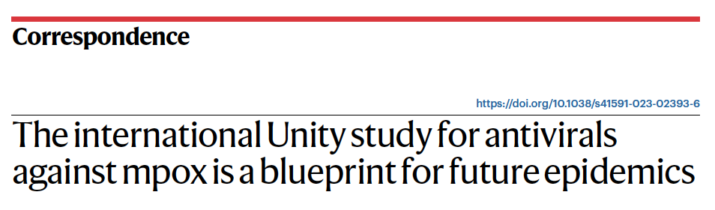
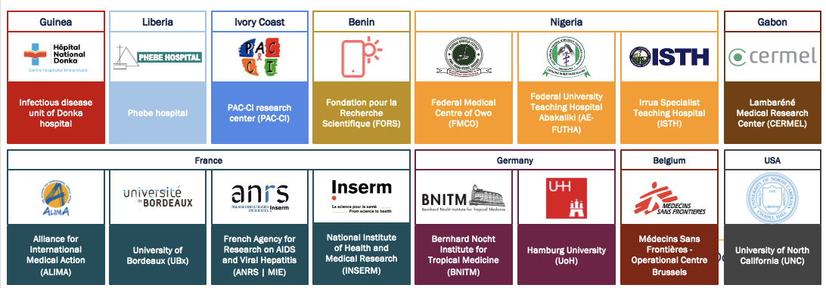
Clinical Research Collaboration in Public Health Emergencies
INTEGRATE

Slide 16
Action Plan – One Approach
Goal: Establish a clinical research collaboration to define the mechanisms underlying organ failure + characterize natural history in high-risk subgroups to inform better supportive care
Develop subspeciality working groups to characterize LF-specific complications and define mechanisms of disease
Neuro → glucose, electrolytes, lumbar puncture
Cardiovascular → ECHO + IVC, troponin, EKG
Renal → FeUrea, urine microscopy, UA, CK
Coagulopathy → Fibrinogen, INR, PTT, ROTEM
Pregnancy
<5 years of age
>50 years of age
*Virus Lineages and outcomes

Slide 17
Next Steps
Identify working group leads and working groups
Generate key data fields to answer clinical questions
Funding
Meeting cadence

